Slide 1
AI: Ethics and Laws 人工智慧：道德與法律的難題
J.-S. Roger Jang (張智星)
MIR Lab, CSIE Dept.
National Taiwan University
jang@mirlab.org, http://mirlab.org/jang

Slide 2
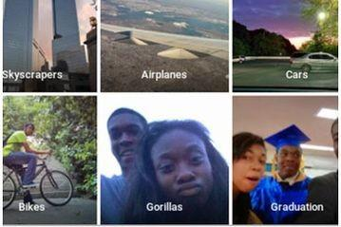
人工智慧的難題：對種族與膚色的偏見 AI Dilemma: Race/Color Discrimination?
2015 年 7 月，谷歌旗下照片應用 Google Photo 把兩名黑人「誤認」成了大猩猩引發了熱議，隨後谷歌連忙致歉，並表示正在改進算法以解決這一問題。
https://kknews.cc/tech/pxgnaqp.html

Slide 3

人工智慧的難題：對種族與膚色的偏見 AI Dilemma: Race/Color Bias
2015年，Johanna Burai在谷歌上搜索「手」的圖片，發現谷歌搜索最前面的結果只有白皮膚的手。隨後，她發起了「全球白網」（World White Web）計劃。
https://kknews.cc/tech/oyjkejq.html
Result of search for “baby” over Google

Slide 4
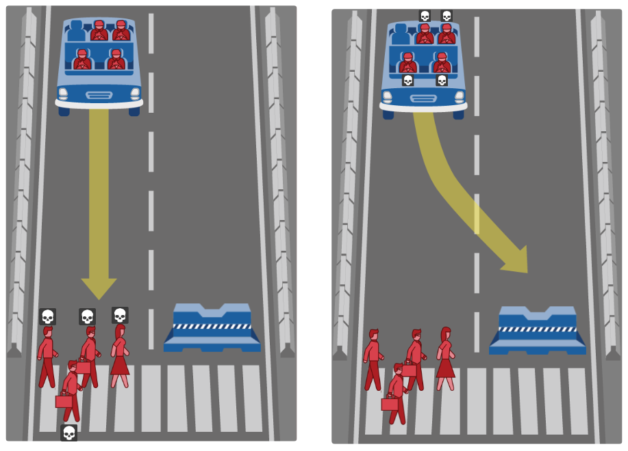
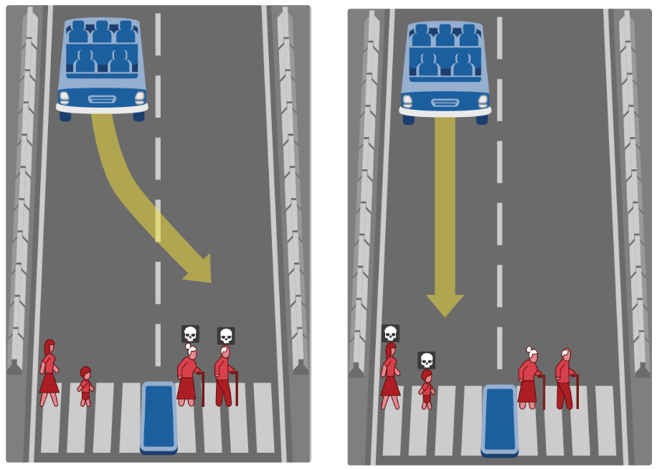
人工智慧的兩難：倫理與道德 (1/2) AI Dilemma: Ethnics & Morality
What should the self-driving car do?
Save you or others?
Judge people (to kill) by what?
http://moralmachine.mit.edu

Slide 5
人工智慧的兩難：倫理與道德 (2/2) AI Dilemma: Ethnics & Morality
想看看…
如果你是軟體設計者，你的決策標準是？
如果你是自駕車商，你要如何說明這輛車的決策？
如果你是立法諸公，你要如何規範處理至些情況？

Slide 6
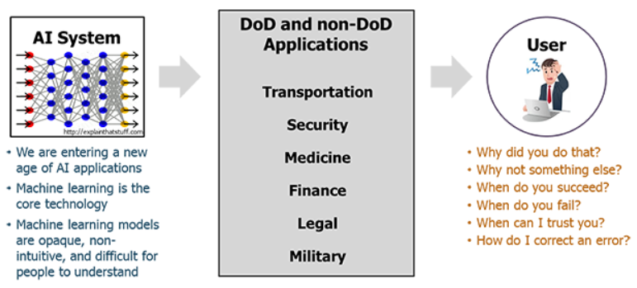
人工智慧難題: 可被解讀與信任嗎？ AI Dilemma: Explainability and Trustability
This is especially important for
Precision medicine, healthcare analytics, financial applications
XAI (explainable AI) is becoming important
DARPA’s 15-year XAI project
Workshop on XAI at IJCAI-2017
https://www.darpa.mil/program/explainable-artificial-intelligence

Slide 7
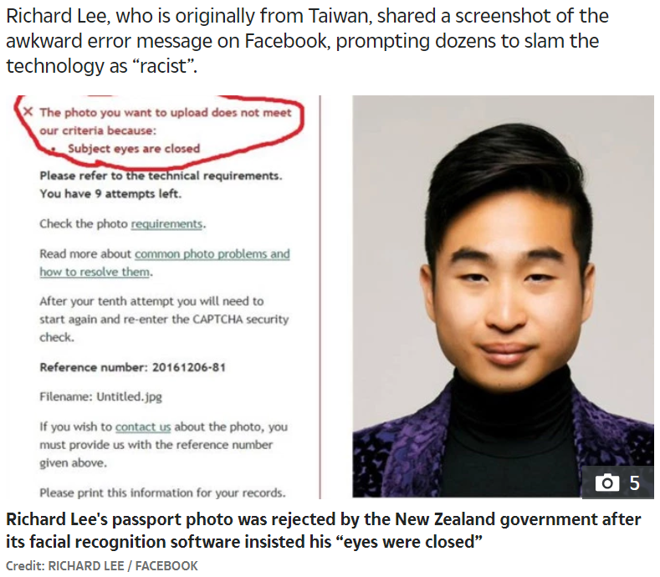
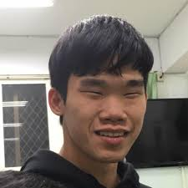
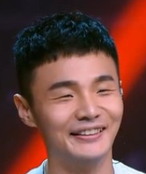
人工智慧難題: 無心的錯誤 AI Dilemma: Innocent Mistake
https://edition.cnn.com/2016/12/07/asia/new-zealand-passport-robot-asian-trnd/index.html

Slide 8


偽造的聲音、圖片與影片
DeepNude
濫用AI技術偽造女性裸照 打擊復仇式色情「DeepNude」在美遭下架 (2019/06/30)
實測人工智能「脫衣」軟件DeepNude，真的那麼強大嗎？ (2019/07/03)
DeepFake

Slide 9
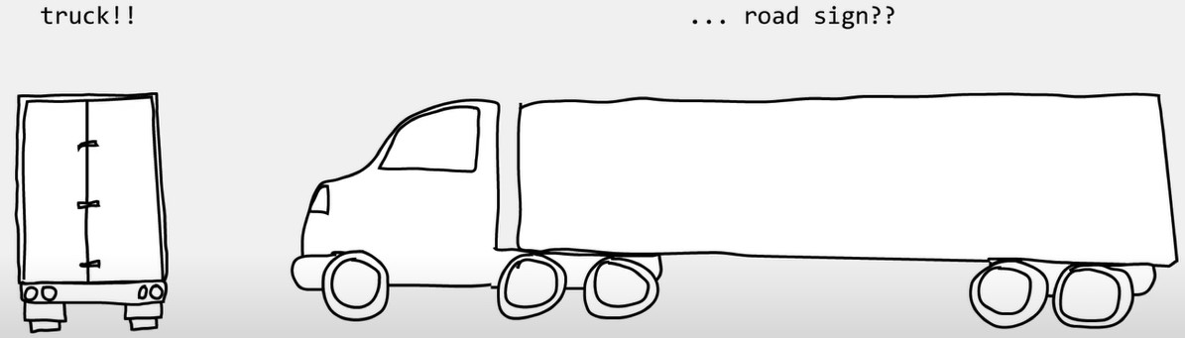
Mistakes by AI/ML: Biased Data
Tesla accident
Source

Slide 10
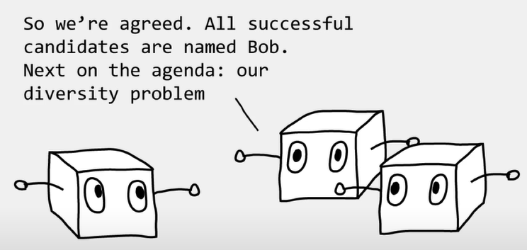
Mistakes by AI/ML: Biased Data
Amazon HR
Source

Slide 11

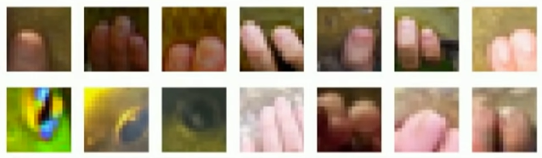

Mistakes by AI/ML: Biased Data
Highlighted part of Tench
Tench
丁鱥
When you google “tench”…

Slide 12
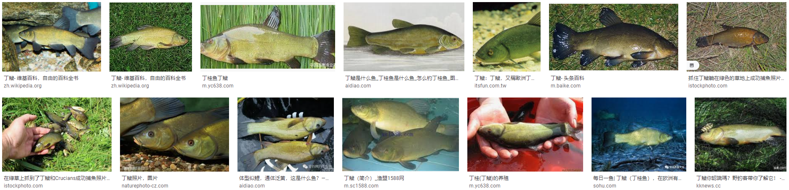
Mistakes by AI/ML: Biased Data
Tench
丁鱥
When you google “丁鱥”…

Slide 13
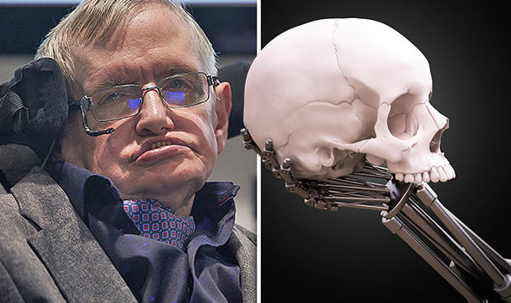
人工智慧將摧毀人類嗎？ How AI Destroys Human?
Humanity’s days are NUMBERED and AI will cause mass extinction, warns Stephen Hawking (2017/11/03)

Slide 14
Conclusions
With the support of ethics and laws, AI will not be fully utilized!
AI’s development needs people from all disciplines.

